Slide 1
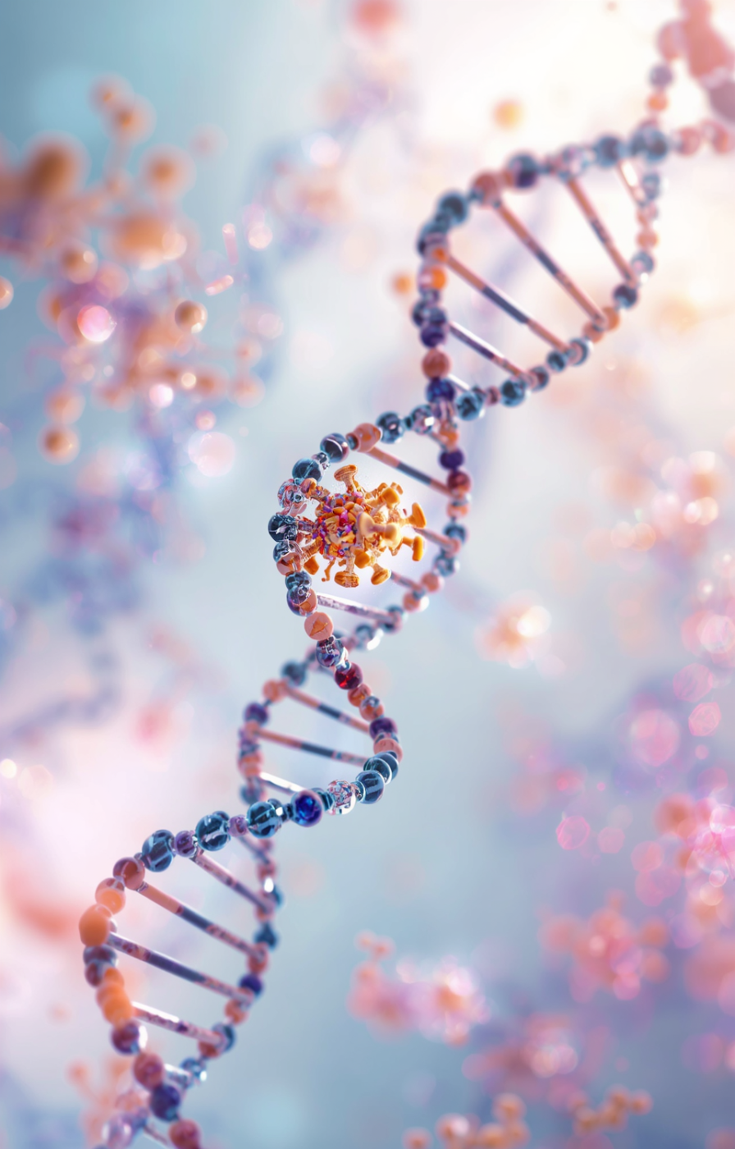
What have we learned from
Next-generation sequencing(NGS) of cancer genomes?
Eylul Turkay
Notes:
Hi, I’m Eylul Turkay.
Today I’ll discuss what we have learned from next-generation sequencing of cancer genomes.

Slide 2
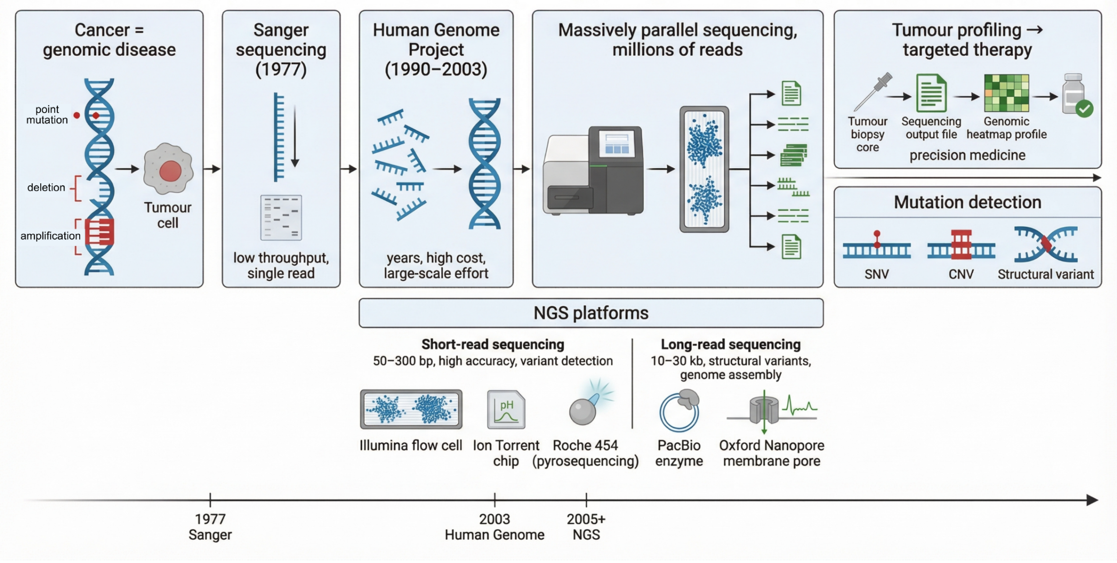
Introduction¹⁻⁴
• Shift from gene-by-gene→ genome-wide analysis
• Enables detection of SNVs, CNAs, and structural variants
• Reveals tumour complexity and heterogeneity
Figure 1. Timeline showing the transition from low-throughput single-gene sequencing to next-generation sequencing (NGS). Adapted from ¹⁻². Created in BioRender.
Notes:
“Cancer used to be studied gene by gene, based on the idea that tumour behaviour is driven by a single dominant mutation.”
👉
“For example, Sanger sequencing produced low-throughput single reads, so analysis was limited to individual genes.”
👉
“The Human Genome Project enabled large-scale sequencing, but it remained slow and expensive.”
👉 (Point to NGS part of figure)
“With next-generation sequencing, we shift to massively parallel sequencing, generating millions of reads at once.”
“This allows genome-wide detection of multiple variant types, including single-nucleotide variants, copy-number changes, and structural variants.”
👉 (Link to bullet 3 explicitly)
“This reveals tumour complexity and heterogeneity, meaning tumours are driven by multiple mutations and pathways rather than a single event.”
🔥 Add clinical link (KEEP SHORT)
“This is important because treatment decisions now depend on identifying multiple alterations rather than targeting one mutation.”
👉 (Move to platform section in figure)
“However, not all sequencing platforms capture the genome equally.”
“Short-read sequencing is highly accurate, above 99.9%, and is widely used clinically for detecting single-nucleotide variants.”
“However, it struggles to detect structural variants and repetitive regions.”
“In contrast, long-read sequencing generates longer reads, which improves detection of structural variants and genome organisation.”
“But this comes with higher error rates and lower clinical use at present.”
🔥 Final line (KEEP EXACTLY THIS)
“So tumour complexity depends on the sequencing method used.”

Slide 3
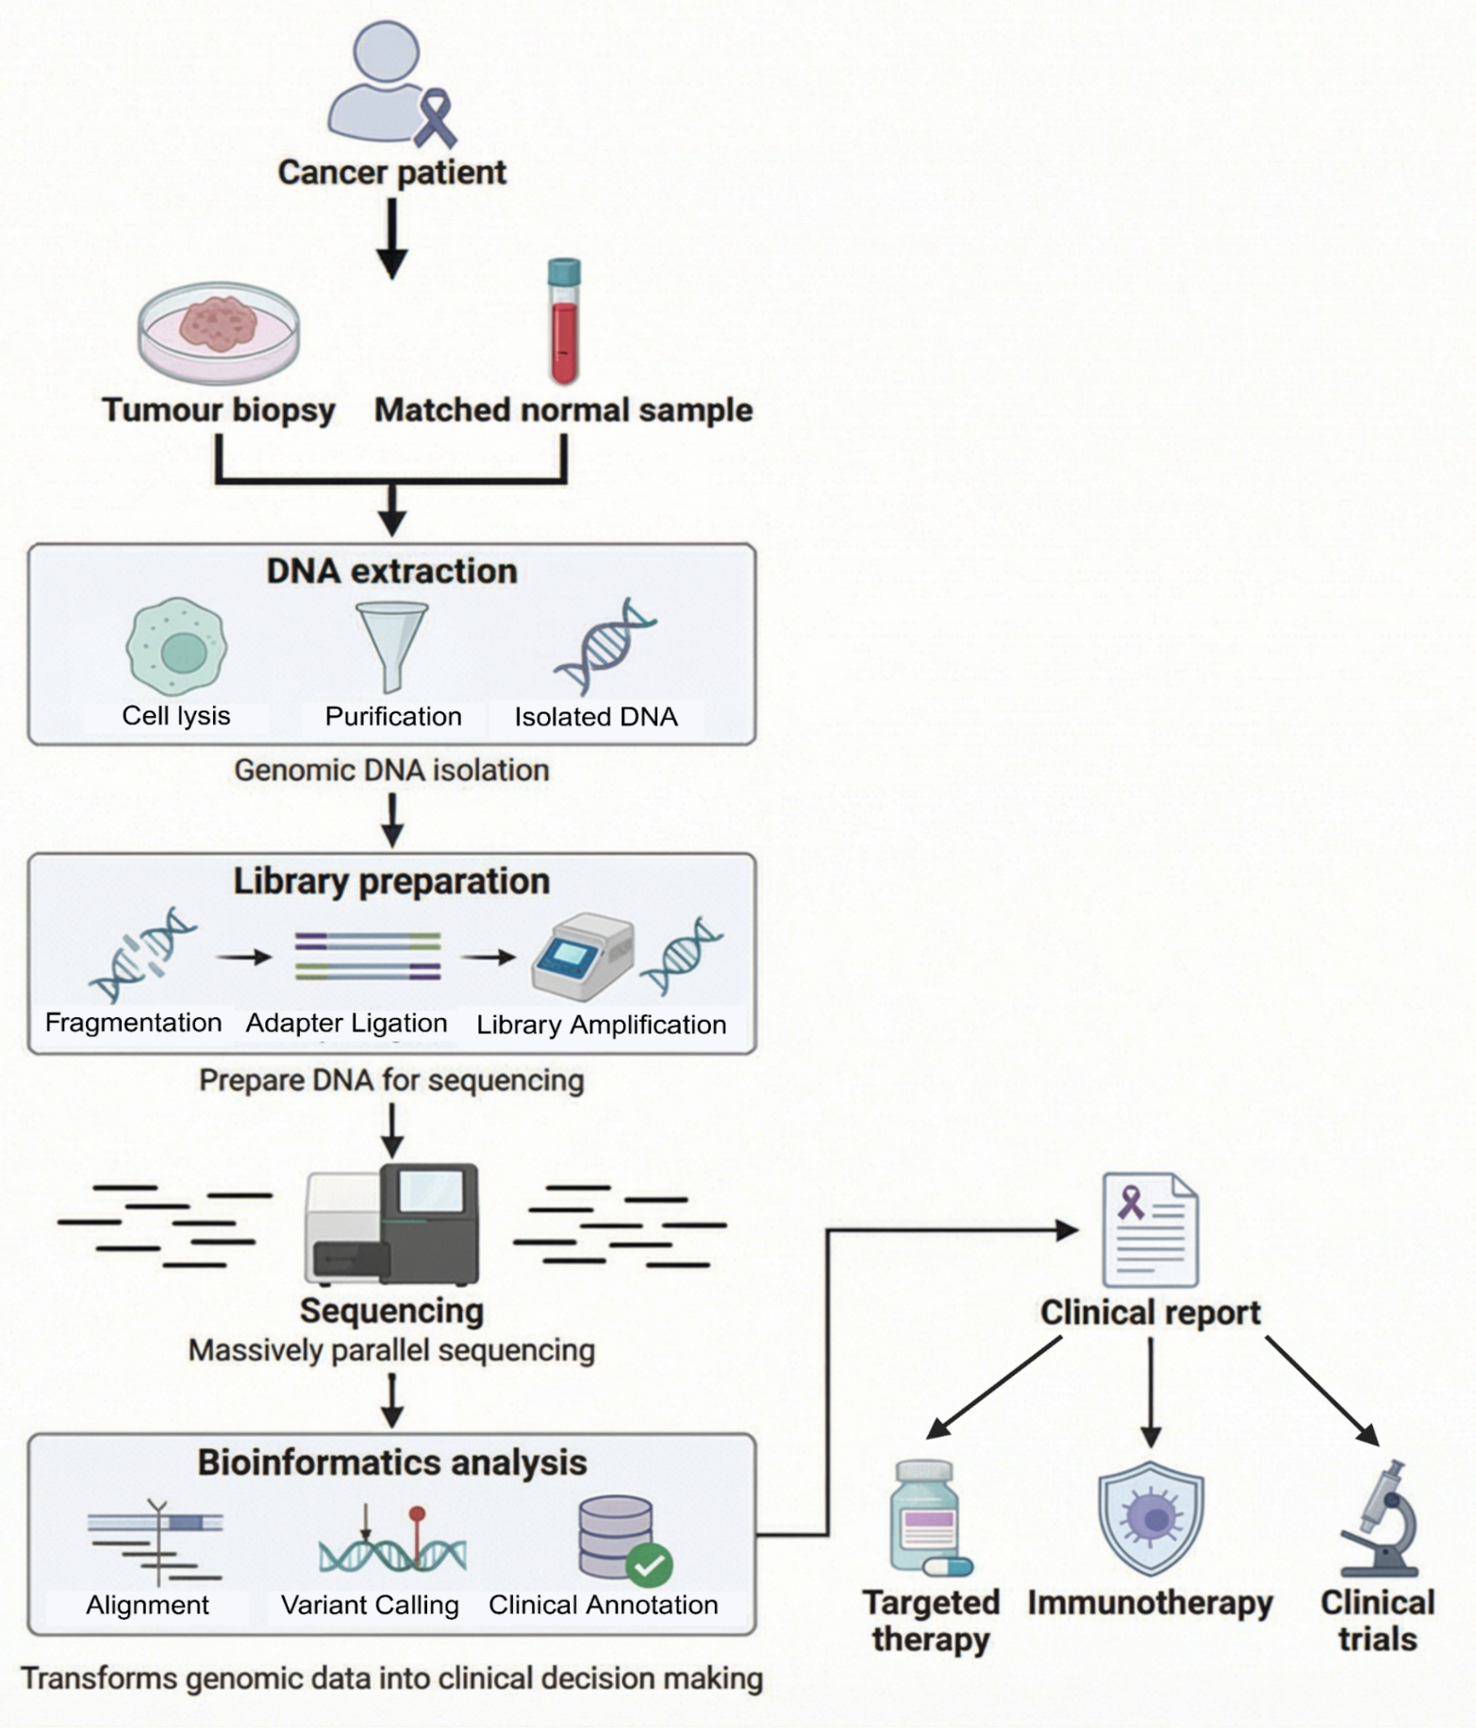
Methodology⁵⁻⁶
• Tumour–normal comparison identifies somatic mutations
• Bioinformatics identifies variants from aligned sequencing reads
• Detection depends on coverage, thresholds, and tumour purity
• Platform-specific errors affect detection
(substitutions in short-read, indels in long-read)
• Observed heterogeneity is influenced by sequencing depth, error rates, and pipeline design
Tumour + normal samples collected
DNA extraction, library prep, sequencing
Bioinformatics → variants → clinical report
Figure 2. Workflow of NGS from tumour and matched normal samples to clinical decision-making. Adapted from ⁵. Created in BioRender.
Notes:
🎤 Slide 3 – Methodology (FINAL VERSION)
“This figure shows how next-generation sequencing generates clinically usable data from tumour and matched normal samples.”
👉
“By comparing tumour and normal DNA, we identify somatic mutations by removing germline variation.”
👉
“The workflow includes DNA extraction, library preparation, sequencing, and bioinformatic analysis.”
👉
“DNA quality is critical. If DNA is degraded, some regions are not sequenced, leading to missed mutations.”
“During library preparation, PCR amplification introduces bias.”
👉
“This causes uneven representation of DNA fragments and distorts allele frequency.”
👉
“Variant detection depends on sequencing depth, tumour purity, and filtering thresholds.”
“If tumour purity is low, tumour DNA is diluted, so some mutations fall below detection thresholds.”
⚠️
“Mutations are not directly observed. They are inferred from read depth and allele frequency.”
👉
“Platform-specific errors further affect detection, particularly for low-frequency mutations.”
“For example, short-read platforms mainly produce substitution errors, while long-read platforms have higher insertion and deletion error rates.”
🔥
“This means clinically important mutations, such as resistance mutations, may be missed at diagnosis.”
🔥
“So tumour heterogeneity is shaped by the sequencing depth,error rates and pipeline design.”

Slide 4
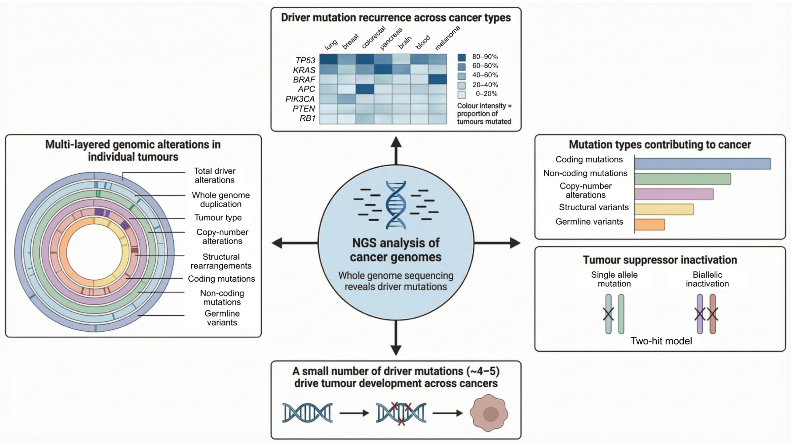
Biological insights³⁻⁴
1. Driver mutations
• Recurrent driver mutations
(TP53, KRAS, PIK3CA)
• Tumour suppressors require a two-hit inactivation
2. Tumour heterogeneity
• Multiple alteration types
(SNVs, CNAs, structural rearrangements)
• Clonal and subclonal populations
3. Detection limitations
• Bulk sequencing averages signals
• Low-frequency subclones may be missed
4. Clinical implications
• Resistant subclones drive relapse
• Evolution inferred from a single time point
Figure 3. Overview of cancer genome features, including recurrent driver mutations, multiple layers of genomic alterations, diverse mutation types, and tumour suppressor inactivation, underlying tumour development. Adapted from ³⁻⁴. Created in BioRender.
Notes:
👉 Driver mutations
“First, this heatmap shows that mutations cluster in a small number of genes such as TP53, KRAS and PIK3CA.”
“This shows that tumour development is not random but driven by key signalling pathways.”
“For example, KRAS mutations in colorectal cancer predict lack of response to EGFR inhibitors.”
👉 Tumour heterogeneity
“Second, the circular plot shows that a single tumour contains multiple types of genomic alterations.”
“These include single-nucleotide variants, copy number changes and structural variants.”
“On average, tumours contain around 4 to 5 driver mutations.”
👉 Two-hit tumour suppressors
“Third, tumour suppressor genes require two-hit inactivation.”
“NGS detects this as a mutation together with copy number loss.”
“This is important because loss of DNA repair genes such as BRCA1 or BRCA2 increases sensitivity to treatment.”
“For example, platinum chemotherapy or PARP inhibitors.”
👉 Clonal and subclonal populations
“Next, tumours contain both clonal and subclonal populations.”
“Subclonal mutations are present at low levels and may be missed.”
👉 Detection limitation
“These data are derived from bulk sequencing, where signals are averaged across many cells.”
“So low-frequency subclones may not be detected and resistant subclones can survive treatment and lead to relapse.
👉 Single time point limitation
“Finally, this analysis is based on a single sample taken at one time point.”
“So NGS helps reconstruct tumour evolution, but it cannot fully capture how the tumour changes over time.”

Slide 5
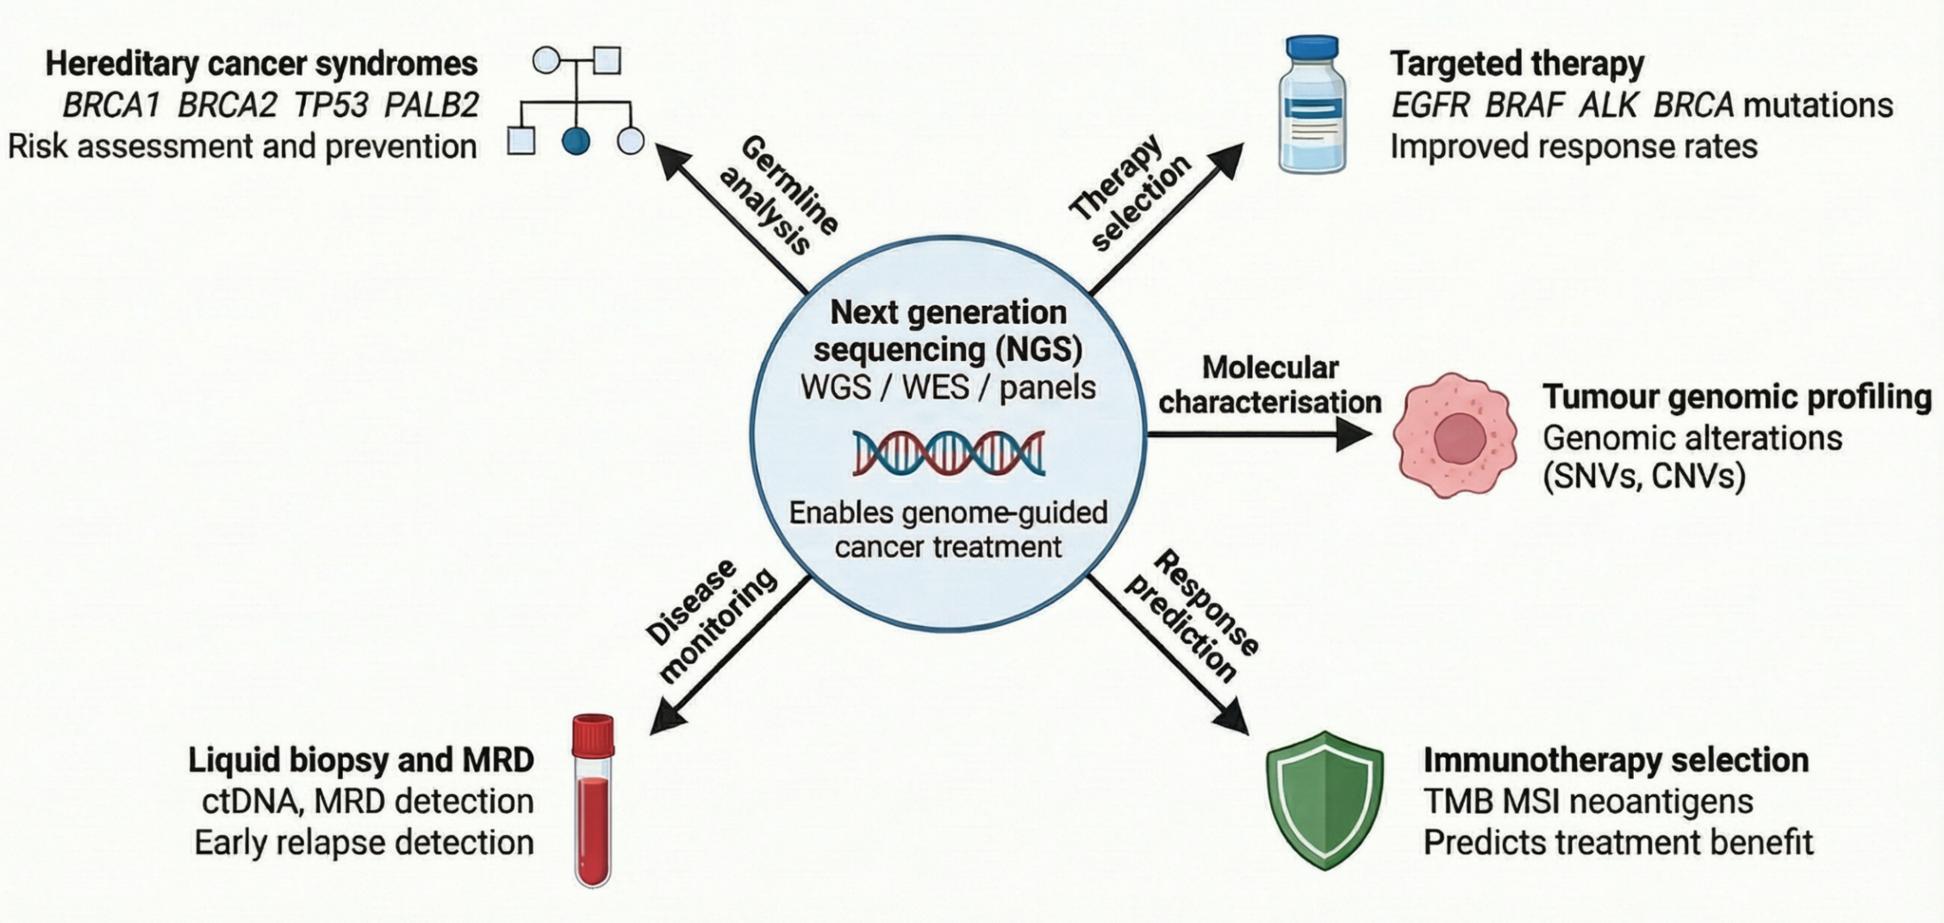
Clinical Applications⁷⁻⁹
1.Tumour profiling
• Genome-wide detection of SNVs, CNVs, structural variants
• Distinguishes driver vs passenger mutations
2. Targeted therapy
• Links mutations to pathways
(EGFR, BRAF, BRCA)
• Therapy depends on pathway activation
3. Immunotherapy selection
• Biomarkers: tumour mutational burden (TMB), microsatellite instability (MSI)
• Predictive value varies across patients
4. Disease monitoring
• ctDNA detects tumour burden and relapse
• Limited sensitivity in early disease
5. Hereditary risk assessment
• Detects germline variants (BRCA1, BRCA2)
Figure 4. Clinical applications of NGS showing its role in tumour profiling, targeted therapy selection, immunotherapy prediction, hereditary risk assessment, and disease monitoring. Adapted from ⁷⁻⁹. Created in BioRender.
Notes:
“This figure shows how next-generation sequencing links tumour genomics to clinical decision-making.”
👉 The first application is tumour profiling.
“NGS enables genome-wide detection of variants and helps identify driver mutations.”
“About 91% of tumours contain at least one driver mutation.”
“However, these mutations are found using computer analysis, not directly seen in the tumour.”
👉 The second application is treatment selection
“Initially, sequencing uses targeted panels to detect clinically actionable mutations.”
“If these are negative, whole exome or whole genome sequencing is used.”
“so the method is selected based on clinical need.”
“Next, this links mutations to the pathways driving the tumour.”
“For example, EGFR mutations activate signalling pathways that promote tumour growth.”
“So EGFR-mutant lung cancer is treated with tyrosine kinase inhibitors.”
“However, resistance mutations such as T790M can develop.”
“These may require repeat sequencing or liquid biopsy to guide treatment changes.”
👉 The third application is immunotherapy selection.
“NGS identifies microsatellite instability and tumour mutational burden.”
“For example, MSI-high colorectal cancers respond well to PD-1 inhibitors.”
“However, these markers do not always predict response.”
👉 The fourth application is disease monitoring.
“NGS detects circulating tumour DNA to monitor relapse.”
“However, sensitivity is limited, especially in early-stage cancer.”
“So a negative result does not rule out disease.”
👉 The fifth application is hereditary risk assessment.
“NGS identifies germline variants such as BRCA1 and BRCA2.”
“This helps guide treatment and assess family risk.”
🔥 Final point (slow down):
“However, many detected variants are not clinically actionable.”
“So genomic data alone is not enough to fully predict clinical outcome.”

Slide 6
Challenges and Future Directions⁵⁻⁶
Data interpretation complexity
Cost and accessibility issues
Ethical issues: consent, privacy
Turnaround time challenges
Need for specialised expertise
Future approaches
• Single-cell sequencing: resolves tumour heterogeneity
• Long-read sequencing: improved detection of structural variants
• Multi-omics: links genotype to function
Core limitation
• Increasing data increases complexity
• Interpretation remains the bottleneck
Figure 5. Key challenges of NGS: data interpretation, cost and accessibility, ethical issues, turnaround time, and need for specialised expertise. Adapted from ⁵⁻⁶.
Notes:
“This slide shows the main challenges of next-generation sequencing.
The first challenge is data interpretation.
“NGS produces thousands of variants, but only a small fraction are biologically relevant.”
The second challenge is cost and accessibility.
“NGS requires specialised sequencing platforms, bioinformatic infrastructure, and trained staff, limiting availability across healthcare systems.”
The third challenge is turnaround time.
Sequencing and analysis can delay treatment decisions.
👉 The fourth challenge is ethical issues including patient consent and data privacy.”
Next, several approaches are being developed to address these limitations.
The first approach is single-cell sequencing.
“This analyses individual tumour cells instead of bulk tissue.”
“It reveals subclonal populations that are missed in bulk sequencing.”
The second approach is long-read sequencing.
“This improves detection of structural variants and gene rearrangements.”
“However, it is not widely used yet due to higher error rates and cost.”
The third approach is multi-omics integration.
“This combines genomic data with transcriptomic and proteomic data.”
“It helps identify which mutations are functionally active.”
🔴 Critical point (say clearly):
“However, these approaches increase data complexity and are not yet widely used in clinical practice.”
🔥 Final close (slow down):
“So the main challenge is interpreting them for clinical decision-making.

Slide 7
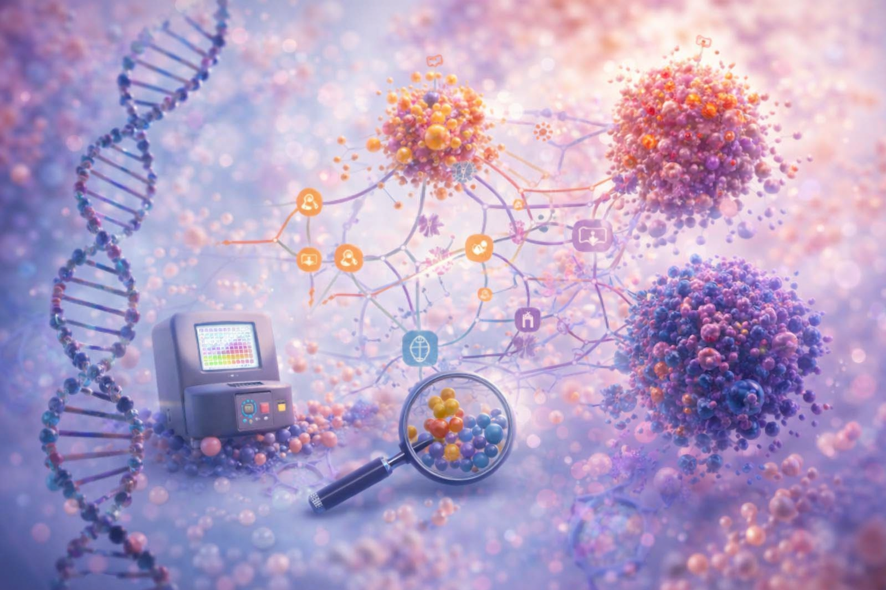
Conclusion^{3-4,7}
1. Cancer biology
Genomically heterogeneous and dynamically evolving
Driven by pathway-level alterations rather than single gene events
2. NGS capability
Enables unbiased genome-wide profiling
Detection is constrained by the sequencing platform, sequencing depth, and analytical pipeline
3. Clinical reality
Only a minority of variants are clinically actionable
Key challenge: identifying biologically meaningful and clinically relevant alterations
Notes:
““To conclude,”
“Next-generation sequencing has shown that cancer is heterogeneous and changes over time.”
“It allows genome-wide profiling of tumours and supports treatment decisions, including targeted therapy and immunotherapy.”
🔴 Pause
“However, most detected variants are not clinically actionable.”
🔥 Final line (slow down):
“So the main challenge is identifying which mutations are biologically meaningful and clinically relevant.”

Slide 8
References
Eren K, Taktakoğlu N, Pirim I. DNA sequencing methods: from past to present. Eurasian J Med. 2022;54(Suppl 1):S47–S56. doi:10.5152/eurasianjmed.2022.22280.
Heather JM, Chain B. The sequence of sequencers: the history of sequencing DNA. Genomics. 2016;107(1):1–8. doi:10.1016/j.ygeno.2015.11.003.
Mardis ER. The impact of next-generation sequencing on cancer genomics: from discovery to clinic. Cold Spring Harb Perspect Med. 2019;9(9):a036269. doi:10.1101/cshperspect.a036269.
Kamps R, Brandão RD, Bosch BJ, Paulussen AD, Xanthoulea S, Blok MJ, et al. Next-generation sequencing in oncology: genetic diagnosis, risk prediction and cancer classification. Int J Mol Sci. 2017;18(2):308. doi:10.3390/ijms18020308.
Satam H, Joshi K, Mangrolia U, Waghoo S, Zaidi G, Rawool S, et al. Next-generation sequencing technology: current trends and advancements. Biology (Basel). 2023;12(7):997. doi:10.3390/biology12070997.
Cheng C, Fei Z, Xiao P. Methods to improve the accuracy of next-generation sequencing. Front Bioeng Biotechnol. 2023;11:982111. doi:10.3389/fbioe.2023.982111.
Ghoreyshi N, Heidari R, Farhadi A, Chamanara M, Farahani N, Vahidi M, et al. Next-generation sequencing in cancer diagnosis and treatment: clinical applications and future directions. Discov Oncol. 2025;16(1):578. doi:10.1007/s12672-025-01816-9.
Kim JW, Na HY, Lee S, Kim JW, Suh KJ, Kim SH, et al. Clinical implementation of next-generation sequencing testing and genomically matched therapy: real-world data in a tertiary hospital. Sci Rep. 2025;15:2171. doi:10.1038/s41598-024-84909-9.
Colomer R, Miranda J, Romero-Laorden N, Hornedo J, González-Cortijo L, Mouron S, et al. Usefulness and real-world outcomes of next generation sequencing testing in patients with cancer: an observational study on the impact of selection based on clinical judgement. eClinicalMedicine. 2023;60:102029. doi:10.1016/j.eclinm.2023.102029.
Acknowledgement:
The cover and conclusion images were generated using AI and are included for visual illustration purposes only.

